Slide 1


Slide 2
Outline
Introduction
Problem
Methodology
Findings
Recommendations

Slide 3
Introduction
The aviation industry is a high-opportunity, high-risk sector.
General aviation has a fatality rate of 1.05 per 100,000 flight hours.
Over 80% of recorded incidents involve private or instructional flights.
Study spans 1982–2022, analyzing 30,000+ aviation incidents.
Goal: Support safe aircraft procurement using historical data.

Slide 4
Problem & Objectives
Problem:
Aircraft safety varies across types and missions.
Lack of structured safety metrics increases investment risk.
The objectives are:
Identify airplanes used for business and private operations.
Compute risk indices based on injury severity and aircraft damage.
Recommend aircraft models with the lowest safety risk for investment consideration.

Slide 5
Methodology
1. Selected Airplanes and Helicopters only.
2. Grouped flight purpose:
Business: Corporate, Ferry, Positioning
Private: Personal, Instructional
Safety Indices:
Survival Index % = (Uninjured / Total) × 100
Severity Index % = (Avg Damage Score / 3) × 100
Minor = 1, Substantial = 2, Destroyed = 3

Slide 6
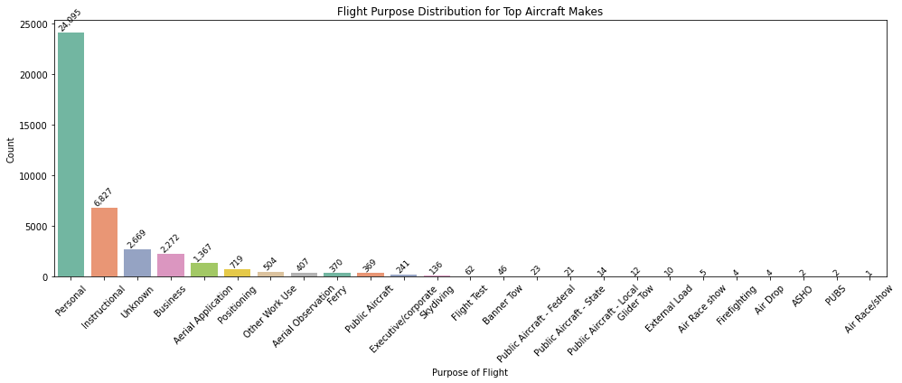
Findings: Flight Purpose Distribution
Personal and instructional flights account for over 80% of incidents.
Business flights form a minority but remain critical for procurement analysis.
Risk profiles differ by flight mission type.
Need to assess safety relative to usage context.

Slide 7
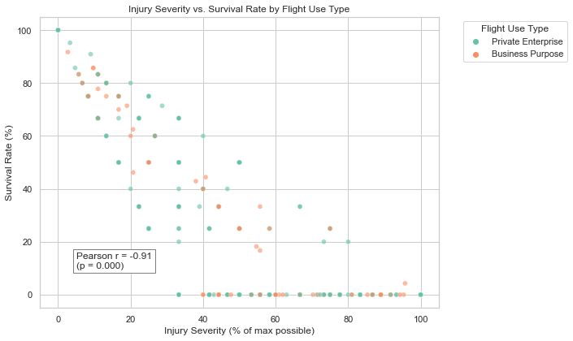
Survival vs Severity

Slide 8
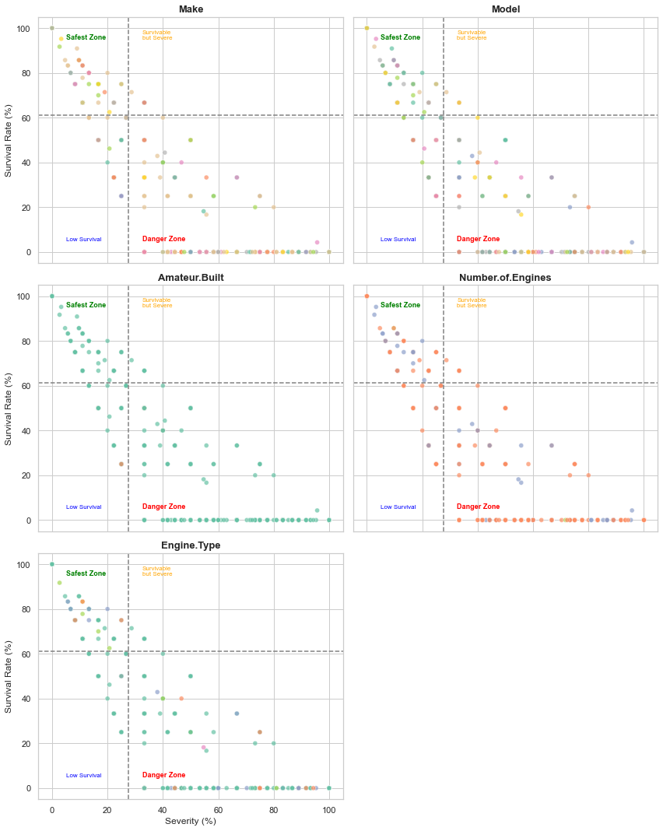

Slide 9
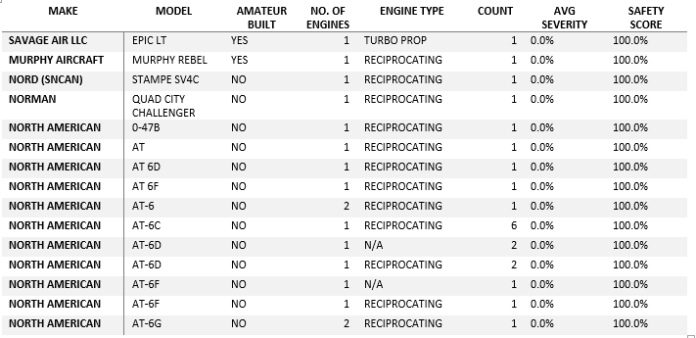

Slide 10
Questions?
Cyrus mutuku, BA-Econ & Mathematics, MA –Economics, MBF-Financial Sector Policy, PGD-customs, Data Scientist!

